Slide 1
Materials properties
قسم الاطراف والمساند
المرحلة الثانية

Slide 2
Unit cells and Crystal systems
When we describing crystal structures, it is often convenient to subdivide the structure into repetitive small repeat entities called unit cells.
Each space lattice can be defined by reference to a unit cell which, when repeated in space an infinite number of times, will generate the entire space lattice. To describe basic crystal structures, the 14 types of unit cells are grouped in seven different classes of crystal lattices, i.e. to describe basic crystal structures, seven different co-ordinate systems of reference axes are required.

Slide 3
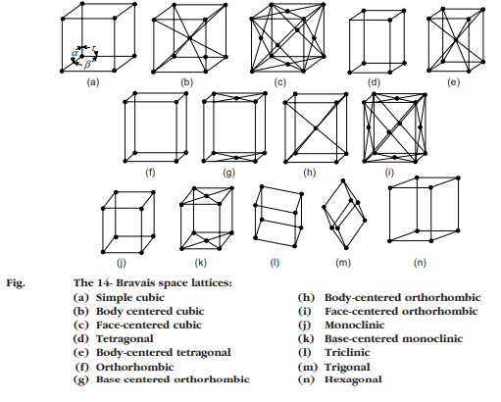
Unit cells and Crystal systems

Slide 4
Bonding between atoms
The various ways in which atoms can be bound together involve
(1) Primary bonds — ionic, covalent or metallic bonds, which are all relatively strong (they generally melt between 1000 and 4000 K) .
(2) Secondary bonds — Van der Waals and hydrogen bonds, which are both relatively weak (they melt between 100 and 500 K).
Primary bonds
Ceramics and metals are entirely held together by primary bonds — the ionic
and covalent bond in ceramics, and the metallic and covalent bond in metals.
These strong, stiff bonds give high moduli.
The ionic bond is the most obvious sort of electrostatic attraction between
positive and negative charges. It is typified by cohesion in sodium chloride.

Slide 5
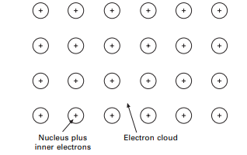
Bonding between atoms
Covalent bonding appears in its pure form in diamond, silicon, and germanium — all materials with large moduli (that of diamond is the highest known).
The metallic bond, as the name says, is the dominant (though not the only) bond in metals and their alloys.

Slide 6
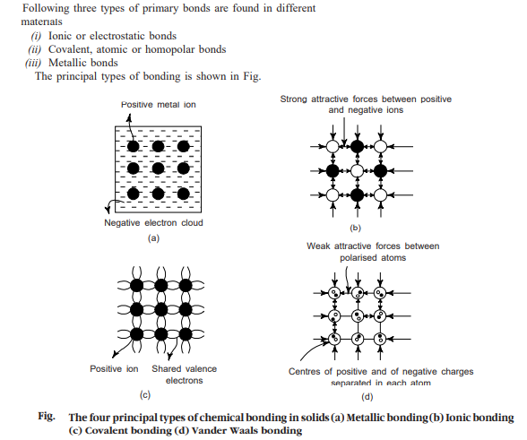
Bonding between atoms

Slide 7
Bonding between atoms
Secondary bonds
Although much weaker than primary bonds, secondary bonds are still very important. They provide the links between polymer molecules in polyethylene (and other polymers) which make them solids.
Without them, water would boil at 80C, and life as we know it on earth would not exist.
Van der Waals bonding describes a dipolar attraction between uncharged atoms. The electronic charge on an atom is in motion; one can think of the electrons as little charged blobs whizzing round the nucleus like the moon around the earth.

Slide 8
Properties of Bonds
Ionic bands.
(i) Ionic solids are generally rigid and crystalline in nature
(ii) these have high melting and boiling points, high modulus of elasticity, and low coefficient of compressibility and linear expansion.
(iii) Ionic solids are generally non-conductors of electricity.
(iv) Ionic solids are highly soluble in water but insoluble in organic solvents.

Slide 9
Properties of Bonds
Covalent bonds
(i) Covalent compounds are mostly gases and liquids.
(ii) They are usually electric insulators.
(iii) They are directional in nature.
(iv) They are insoluble in polar solvents like water but are soluble in non-polar solvents, e.g,, benzene, chloroform, alcohol, paraffins etc.
(v) Covalent compounds are soft, rubbery elastomers, and form a variety of structural materials usually termed as plastics. The melting and boiling points of these compounds are low.
(vi) In the exceptional case of diamond covalent bonding is very strong due to the very large cohesive energy

Slide 10
Properties of Bonds
Metallic bonds
(i) Metallic compounds are crystalline in nature due to the symmetrical arrangements of the positive ions in a space lattice .
(ii) Metallic compounds are good conductors of heat and electricity. They have high electrical conductivity and higher thermal conductivity.
(iii) metals have a melting point moderate to high.
(iv) Metals are opaque to light, because the free electrons in a metal absorb light energy.
(v) Metallic crystals have high reflectivity.

