Slide 1
قسم الاطراف والمساند المرحلة الثانية
Material properties

Slide 2
Metals
Why Metals Are Important
• High stiffness and strength - can be alloyed for high
rigidity, strength, and hardness
• Toughness - capacity to absorb energy better than
other classes of materials
• Good electrical conductivity - Metals are conductors
• Good thermal conductivity - conduct heat better than
ceramics or polymers
• Cost –the price of steel is very competitive with other
engineering materials

Slide 3
Metals
Classification of Metals
• Ferrous - those based on iron
Steels
Cast irons
• Nonferrous - all other metals
Aluminum, magnesium, copper, nickel, titanium,
zinc, lead, tin, molybdenum, tungsten, gold, silver,
platinum, and others
• Superalloys

Slide 4
Iron
Iron ores are rocks and minerals from which metallic iron can be economically extracted. The ores are usually rich in iron oxides and vary in color from dark grey, bright yellow, deep purple, to rusty red. Iron ore is the raw material used to make pig iron, which is one of the main raw materials used to make steel. Ninety-eight percent of the mined iron ore is used to make steel.
Iron is produced by converting iron ore to pig iron using a blast furnace. Pig iron is the intermediate product of smelting iron ore with coke, usually with limestone as a flux. Pig iron has a very high carbon content, typically 3.5–4.5%, which makes it very brittle and not useful directly as a material except for limited applications.
From pig iron, many other types of iron and steel are produced by the addition or deletion of carbon and alloys.

Slide 5
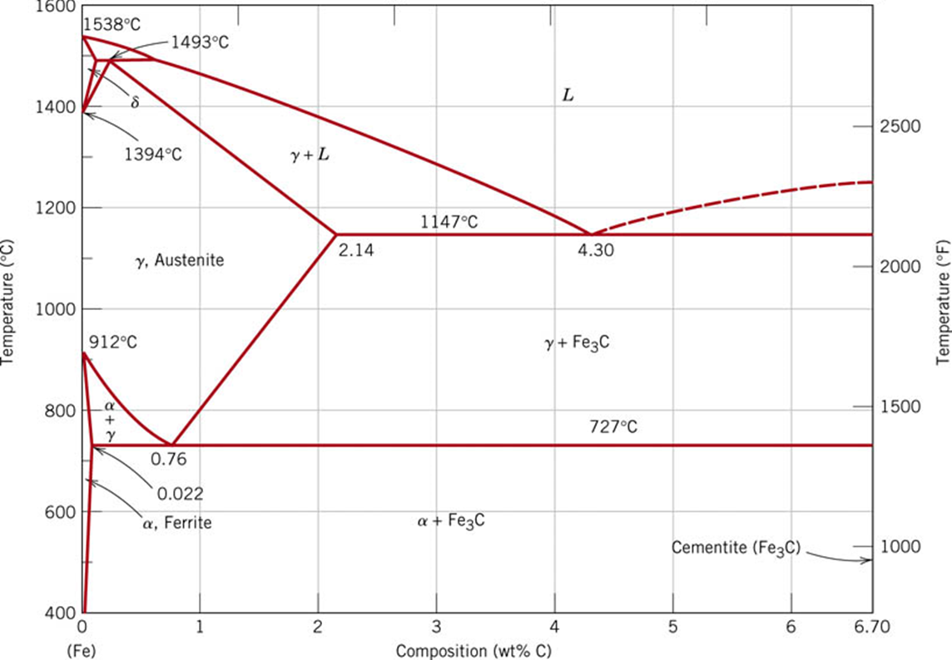
The Iron-carbon Phase Diagram

Slide 6
Iron
Types of the iron
Cast Iron — any iron containing greater than 2% carbon alloy.
Steel --- any iron containing less than 2% carbon alloy

Slide 7
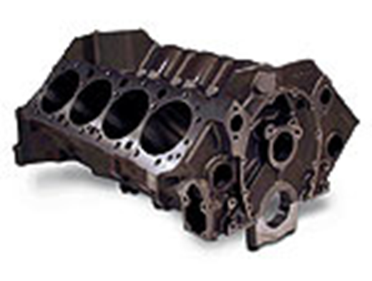
Cast Iron
Besides iron, cast iron contains carbon, silicon, sulpher, phosphorus and manganese in varying proportions:
Iron – 92-95%
Carbon – 2- 4.5 %
Silicon- 1-3 %
Very hard and brittle
Strong under compression
Suitable for casting [can be pour at a relatively
low temperature]
Engine block, engineer vices, machine parts

Slide 8
Cast Iron
Types of Cast Irons
• Most important is gray cast iron
• Other types include ductile iron, white cast iron,
malleable iron, and various alloy cast irons
• Ductile and malleable irons possess chemistries
similar to the gray and white cast irons, respectively, but result from special processing treatments

Slide 9
Cast Iron
White:
Hard and brittle, good wear resistance
Uses: rolling & crunching
Equipment
Grey:
Good compressive & tensile strength, machinability, and vibration-damping ability
Uses: machine bases, crankshafts, furnace doors, Engine Blocks

Slide 10
Cast Iron
Ductile:
High strength and ductility Uses: engine and machine parts
Malleable:
Heat-treated version of white cast iron

Slide 11
Cast Iron
Uses:
1. It is used for manufacture of steel and wrought iron.
2. Its high compressive strength makes it suitable for use in making such parts which are subjected to compressive stresses such as supports of heavy machinery.
3. Since it does not rust easily, therefore it is used for parts generally exposed to atmosphere such as lamp posts.
4. It is also used for making rail chairs and carriages wheels.

Slide 12
Cast Iron
Cast iron possesses the following important properties:
1. It has fibrous crystalline structure.
2. Brittle and has low resistance to tension and high strength in compression. Tensile and compressive strength of an average quality of cast iron are 150 N/mm2 and 500 N/mm2 respectively.
3. Its melting point is about 1200 °C.
4. It cannot withstand sudden shocks.
5. Because of being brittle, it can not be welded.
6. Its specific gravity is 7.5.
7. It cannot be magnitude.
8. it’s neither malleable, nor ductile.
9. It does not rust easily.

Slide 13
Steel
Steel is the most important material for engineering construction. It contains carbon from 0.15 % (very soft steel) to 1.5 % (very hard steel). It also contains small amount of other elements.
It contains from:
Iron = 99 %
Carbon content – 0.15 – 1.5 %
Phosphorus and sulpher less than o.1 %
Manganese up to 0.5 %
Silicon up to o.3 %
The higher is the percentage of the carbon, the harder and tougher is the steel.

Slide 14
Steel
Stainless steel (SS) is the general name for a number of different steels used mainly because of its resistance to a wide range of corrosive agents. SS is used to fabricate some prosthetic parts in fields such as dental implant ology, prosthetic dentistry, and orthopedics. It possesses good mechanical properties but suffers from poor biocompatibility. Infections and lack of Osseo integration are the further existing drawbacks of these implants in the human body Singh and Dahotre initially reported that stainless steel implants are often degraded due to crevice, pitting, fretting corrosion fatigue, stress corrosion cracking,

Slide 15
Steel
An alloy of iron containing from 0.02% and 2.11% carbon by weight
• It is the carbon content that turns iron into steel
• Often includes other alloying elements:
manganese,chromium, nickel, and molybdenum
• Steel alloys can be grouped into four categories:
1. Plain carbon steels
2. Low alloy steels
3. Stainless steels
4. Tool steels

Slide 16
Steel
Depending upon the percentage of carbon contents, plain carbon Steel can be classified into different groups as under:
1. Very low carbon steel – having percentage of carbon below 0.15 %.
2. Low carbon steel or mild steel –Carbon contents 0.15 – 0.3 %.
3. Medium carbon steel–Carbon contents range from 0.3 – 0.6 %.
4. High carbon steel or hard steel–Carbon contents range from 0.6 – 1.5 %.

Slide 17
Plain Carbon Steels
Carbon is the principal alloying element, with only small amounts of other elements (about 0.5% manganese is normal)
• Strength of plain carbon steels increases with carbon content, but ductility is reduced
• High carbon steels can be heat treated to form martensite, making the steel very hard and strong

Slide 18
Plain Carbon Steels
1. Low carbon steels - contain less than 0.20% C
Applications: automobile sheetmetal parts, plate steel for fabrication, railroad rails
2. Medium carbon steels - range between 0.20% and 0.50% C
Applications: machinery components and engine parts such as crankshafts and connecting rods
3. High carbon steels - contain carbon in amounts greater than 0.50%
Applications: springs, cutting tools and blades, wear-resistant parts

Slide 19
Low alloy steels
Iron-carbon alloys that contain additional alloying elements in amounts totaling less than 5% by
weight
• Mechanical properties superior to plain carbon steels for given applications
• Higher strength, hardness, hot hardness, wear resistance, toughness, and more desirable combinations of these properties
• Heat treatment is often required to achieve these improved properties

Slide 20
Stainless Steel (SS)
Highly alloyed steels designed for corrosion resistance :-
• Principal alloying element is chromium, usually
greater than 15%
- Cr forms a thin impervious oxide film that protects
surface from corrosion
• Nickel (Ni) is another alloying ingredient in certain SS
to increase corrosion protection
• Carbon is used to strengthen and harden SS, but
high C content reduces corrosion protection since
chromium carbide forms to reduce available free Cr

Slide 21
Stainless Steel (SS)
Properties of Stainless Steels
• In addition to corrosion resistance, stainless steels
are noted for their combination of strength and
ductility
- While desirable in many applications, these
properties generally make SS difficult to work in
manufacturing
• Significantly more expensive than plain C or low alloy steels

Slide 22
Stainless Steel (SS)
Types of Stainless Steel
• Classified according to the predominant phase present at ambient temperature:
1. Austenitic stainless - typical composition 18% Cr and 8% Ni
2. Ferritic stainless - about 15% to 20% Cr, low C, and no Ni
3. Martensitic stainless - as much as 18% Cr but no Ni, higher C content than ferritic stainless

Slide 23
Tool Steels
A class of (usually) highly alloyed steels designed for use as industrial cutting tools, dies, and molds
• To perform in these applications, they must possess high strength, hardness, hot hardness, wear resistance, and toughness under impact
• Tool steels are heat treated

Slide 24
Tool Steels
Classification of Tools Steels
(T, M) High-speed tool steels - cutting tools in machining
(H) Hot-working tool steels - hot-working dies for forging,
extrusion, and die-casting
(D) Cold-work tool steels - cold working dies for sheetmetal
pressworking, cold extrusion, and forging
(W) Water-hardening tool steels - high carbon but little else
(S) Shock-resistant tool steels - tools needing high
toughness, as in sheetmetal punching and bending
(P) Mold steels - molds for molding plastics and rubber

